Slide 1
DIABETIC RETINOPATHY DETECTION USING DEEP LEARNING TECHNIQUES
Domain : Deep learning
Batch no: A5
Guide : Team Members:
Mrs: K.Kiruthika M.Tech Charulatha.K (211417104042)
Assistant professor Jayasri.K(211417104092)
Kamathampalli Jayasri Reddy
(211417104105)

Slide 2
INTRODUCTION
Diabetic retinopathy (DR) is a common complication of diabetes associated with retinal vascular damage caused by long standing diabetes.
The diagnosis of DR mostly depends on the observation and evaluation to fundus photographs.
It improve the screening rate of DR and reduce the number of blindness.
For a deep learning model, the most important parts that should be focused on are data set, network architecture and training method.

Slide 3
Literature Survey
S.No | Journal name, Year | Author Name | Paper Title | Methodology | Merits
1 | International Journal of Recent Technology and Engineering (IJRTE) (2017) Volume 7 | Yogesh Kumaran, Chandrashekar M. Patil | A Brief Review of the Detection of Diabetic Retinopathy in Human Eyes Using Pre-Processing & Segmentation Techniques ¹ | A brief insight into the detection of DR in human eyes using different types of preprocessing & segmentation techniques is being presented. | It can detect DR at an early stage by segmented retinal fibre.

Slide 4
S.No | Journal name, Year | Author Name | Paper Title | Methodology | Merits
2 | Published as a conference paper at ICLR 2015 (2017) | Diederik P. Kingma, Jimmy Lei Ba | A Method for Stochastic optimization ² | An algorithm for first-order gradient-based optimization of stochastic objective functions, based on adaptive estimates of lower-order moments. | It is simple and computationally efficient algorithm The method is straightforward to implement

Slide 5
S.No | Journal name, Year | Author Name | Paper Title | Methodology | Merits
3 | Proceedings of the 32nd International Conference on Machine Learning, PMLR , 2015. | Sergey Ioffe, Christian Szegedy | Batch Normalization: Accelerating Deep Network Training by Reducing Internal Covariate shift ³ | Our method draws its strength from making normalization a part of the model architecture and performing the normalization for each training mini-batch. | 4.9% top-5 validation, exceeding the accuracy of human raters. It presents some algorithm

Slide 6
S.No | Journal name, Year | Author Name | Paper Title | Methodology | Merits
4 | International Conference On Medical Imaging Understanding and Analysis 2016, MIUA 2016, 6-8 July 2016, Loughborough, UK Volume 90 |  | Convolutional Neural Networks for Diabetic retinopathy ⁴ | we propose a CNN approach to diagnosing DR from digital fundus images and accurately classifying its severity | This method produces comparable results without any feature-specific detection and using a much more general dataset

Slide 7
S.No | Year | Author Name | Paper Title | Methodology | Merits
5 | 2017 | Alexander Rakhlin | Diabetic Retinopathy detection through integration of Deep learning classification framework ⁵ | We make use of deep Convolutional Neural Networks (CNNs), which have proven revolutionary in multiple fields of computer vision including medical imaging, and we bring their power to the diagnosis of eye fundus images | It increase the accuracy of the method as well as to expand it to other eye diseases.

Slide 8
S.No | Journal name, Year | Author Name | Paper Title | Methodology | Merits
6 | 2015 Featured Prediction Competition | Mohit Singh Solanki, Dr. Amitabha Mukherjee | Diabetic Retinopathy Detection Using Eye images ⁶ | This project we are using supervised learning methods to classify a given set of images into 5 classes | It is a attempt towards finding a automated way to detect this disease in its early phase.

Slide 9
S.No | Journal name, Year | Author Name | Paper Title | Methodology | Merits
7 | 2018 IEEE International Symposium on Biomedical Imaging | Prasanna Porwal , Samiksha Pachade | Indian Diabetic Retinopathy Image Dataset (IDRiD): A Database for Diabetic Retinopathy Screening research ⁷ | Computer-aided disease diagnosis in retinal image analysis could ease mass screening of populations with diabetes mellitus and help clinicians in utilizing their time more efficiently | Computer-aided disease diagnosis help clinicians in utilizing their time more efficiently

Slide 10
S.No | Joural name, Year | Author Name | Paper Title | Methodology | Merits
8 | 2015 British journal of opthalmology | Rupert R A Bourne,Jost B Jonas | Prevalence and causes of vision loss in high income countries and in Eastern and Central Europe in 2015: magnitude, temporal trends and projections ⁸ | Based on a systematic review of medical literature, prevalence of blindness, moderate and severe vision impairment (MSVI), mild vision impairment and presbyopia was estimated | It improves the accuracy of ongoing surveillance efforts to inform health policy in Vision impairment

Slide 11
S.No | Year | Author Name | Paper Title | Methodology | Merits
9 | 2019 | Imran Qureshi, Jun Ma | Recent Development on Detection Methods for the Diagnosis of Diabetic retinopathy ⁹ | Early screening through computer-assisted diagnosis (CAD) tools and proper treatment have the ability to control the prevalence of DR. | It is highly reliable, fast, and real-time diagnosis settings of diabetic retinopathy

Slide 12
S.No | Journal name, Year | Author Name | Paper Title | Methodology | Merits
10 | 2015 IEEE Conference on Computer Vision and Pattern Recognition (CVPR), 2016 | Christian Szegedy, Vincent Vanhoucke | Rethinking the Inception Architecture for Computer vision ¹⁰ | Here we are exploring ways to scale up networks in ways that aim at utilizing the added computation as efficiently as possible by suitably factorized convolutions and aggressive regularization | It can lead to high performance vision networks and simpler in cost

Slide 13
PROBLEM STATEMENT
The main difficulty faced by DR affected patients is that they are unaware of the disease until the changes in the retina have progressed to a level that treatment will in turn tend to be less effective.
Automated screening techniques for the detection purpose have great significance in saving cost, time and labor.
The screening of diabetic patients for the development of diabetic retinopathy can reduce the risk of blindness by 50%.
we can quickly detect Diabetic Retinopathy with high accuracy from our trained neural network and our system will help to reduce the damage cause by diabetic retinopathy at early stage.

Slide 14
TECHNOLOGY STACK Software Requirements
Operating System : Windows 7 , 8, 10 (64 bit)
Software : Python 3.7
Tools : Anaconda(Jupyter Note Book IDE)
Hardware Requirements
Hard Disk : 500GB and Above
RAM : 4GB and Above
Processor : I3 and Above

Slide 15
SYSTEM ARCHITECTURE
Training images
Input images
Trained dataset
Preprocessing
Feature dataset
Feature extraction
Feature matching
CNN layer
Matching score

Slide 16
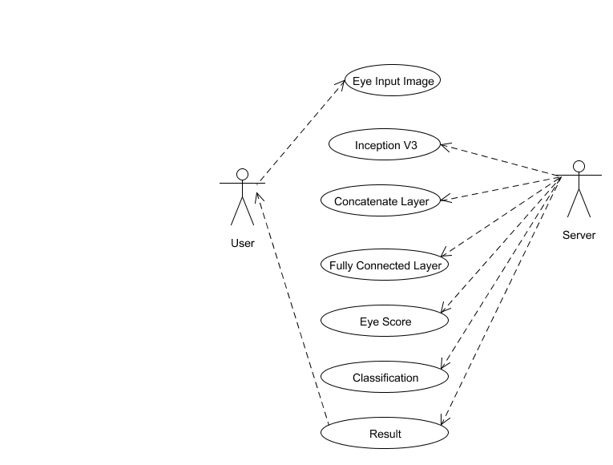
Use case Diagram

Slide 17
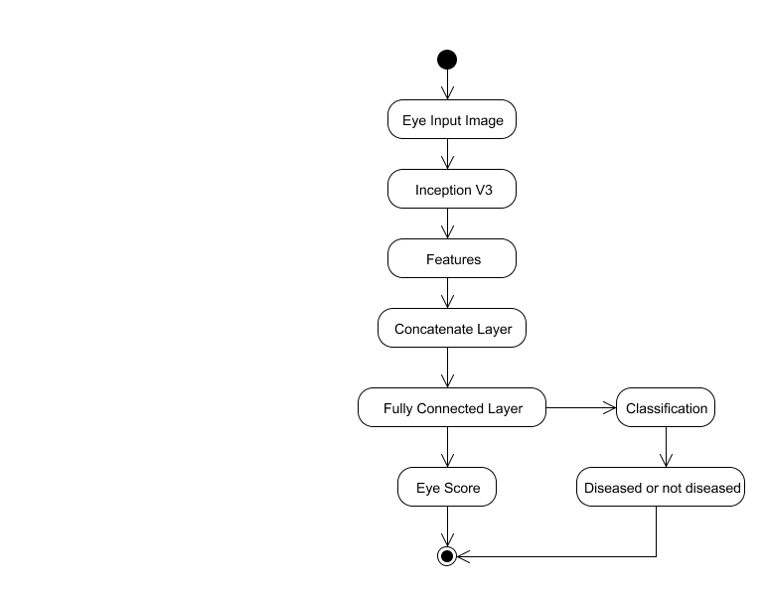
Activity Diagram

Slide 18
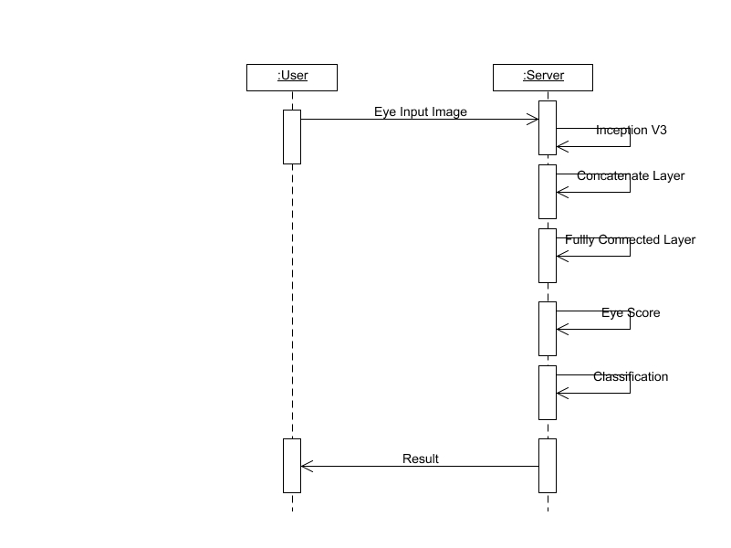
Sequence Diagram

Slide 19
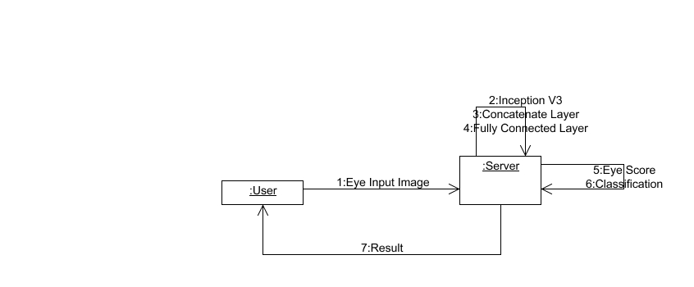
Collaboration Diagram

Slide 20
Modules
Image Pre-Processing
Convolution Neural network
Prediction and Matching Score

Slide 21
Image Pre-Processing
Dataset is a primary and signiﬁcant part that needs to be dealt with for a deep learning application.
Collecting the healthy and affected eye images through OCT [Optical Coherence Tomography] scan
This model accepts two funds images corresponding to the left eye and right eye as inputs
Involving the preprocessing step we have to convert the RGB images to grey scale and resize the image from the collected image.

Slide 22
In training phase, the input of the CNN algorithm will be the preprocessed training data. As the input goes iteratively through each layer (convolutional, pooling, and fully connected), it will identify the features in the images.
The layers in the algorithm will find the best features which are needed for classification using feature maps.
The algorithm will first classify whether the patient is suffering from disease or not. If the patient is suffering from the disease, then it will check the severity level of his disease. The output for this will be the patient’s severity level

Slide 23
Convolution Neural network
Convolution neural network is a subset of deep learning neural network. It is mainly used for image classification and image analysis
The goal behind CNN is to do how human brain analyzes the image.
Convolution neural network is comprised of one or more convolutional layers and then followed by one or more fully connected layers.
The convolution layer of CNN will extract features from the source image.
The CNN consist of input, hidden and output layer.

Slide 24
The input layer basically consists of arrays of pixels. The hidden layer is the most important layer as it plays the main role in image computation.
Hidden layer comprises of activation functions and biases. The output layer helps us to determine the class score
A Convolutional Neural Network can takes image as an input , assign importance (learnable weights and biases) to various aspects/objects in the image and be able to differentiate one from the other.
It Splitting the images into testing set and training set.Training set has larger number of dataset then the training set

Slide 25


Slide 26
PREDICTION AND Matching Score
CNN accepts the image as an input and it will test the input images and predict that the patient is suffering from the disease or not.
If the patient is suffering from the disease, then it will check the severity level of his disease. The output for this will be the patient’s severity level.
The confusion matrices of prediction results of left eye, right eye, and both eyes together. The prediction results of the left eye and the right eye have very similar distribution patterns, indicating that the data partition method preserves the original image categories distribution of left eyes and right eyes.

Slide 27
TESTING
Testing is a process of executing a program with the intent of finding an error.
A good test case is one that has a high probability of finding an as-yet –undiscovered error.
A successful test is one that uncovers an as-yet- undiscovered error.
WHITE BOX TESTING
This testing is also called as Glass box testing. In this testing, by knowing the specific functions that a product has been design to perform test can be conducted that demonstrate each function is fully operational at the same time searching for errors in each function.
BLACK BOX TESTING
In this testing by knowing the internal operation of a product, test can be conducted to ensure that “all gears mesh”, that is the internal operation performs according to specification and all internal components have been adequately exercised.

Slide 28
INTEGRATION TESTING
Integration testing is a systematic technique for constructing the program structure while at the same time conducting tests to uncover errors associated with. Individual modules, which are highly prone to interface errors, should not be assumed to work instantly when we put them together.
PROGRAM TESTING
The logical and syntax errors have been pointed out by program testing. A syntax error is an error in a program statement that in violates one or more rules of the language in which it is written. An improperly defined field dimension or omitted keywords are common syntax error. These errors are shown through error messages generated by the computer
VALIDATION TESTING
Validation testing can be defined in many ways, but a simple definition is that validation succeeds when the software functions in manner that is reasonably expected by the customer. Software validation is achieved through a series of black box tests that demonstrate conformity with requirement

Slide 29
SOFTWARE TESTING STRATEGIES
A software testing strategy provides a road map for the software developer. Testing is a set activity that can be planned in advance and conducted systematically. For this reason a template for software testing a set of steps into which we can place specific test case design methods
USER ACCEPTANCE TESTING
User acceptance of the system is key factor for the success of any system. The system under consideration is tested for user acceptance by constantly keeping in touch with prospective system and user at the time of developing and making changes whenever required.
This is done in regarding to the following points.
Input screen design.
Output screen design

Slide 30
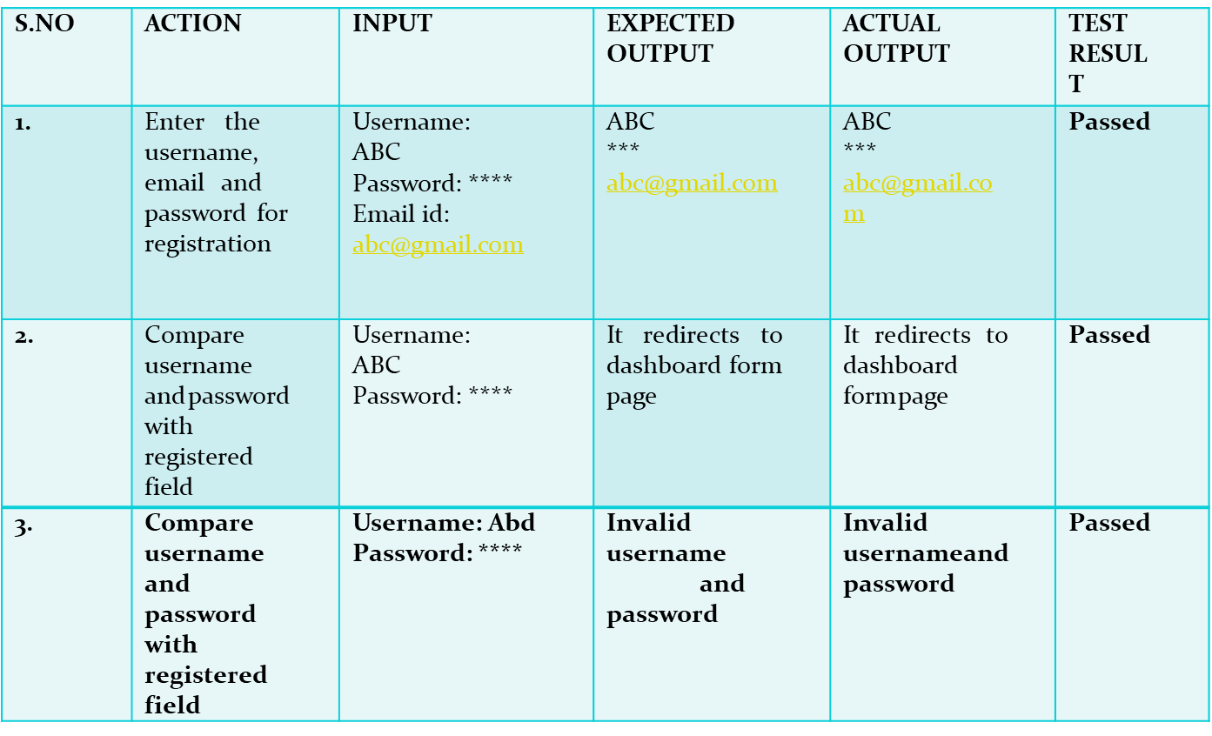
TEST CASES Login page (module 3)

Slide 31
Input page (Module2 & 3)
S.NO | ACTION | INPUT | EXCEPECT ED OUTPUT | ACTUAL OUTPUT | TEST CASE
4. | By clicking choose file test box Upload input image for analysing accuracy range of diabetic retinopathy | xyz.jpeg | Accuracy range of diabetic retinopathy | Accuracy range of diabetic retinopathy | Passed
5. | By clicking choose file test box Upload input image for analysing accuracy range of diabetic retinopathy | xyz | Error page Will be display | Error page will be display | Passed
6. | Analysing the accuracy of diabetic retinopathy by giving the name of the image | 328_right.jpeg | Accuracy range of diabetic retinopathy | Accuracy range of diabetic retinopathy | Passed
7. | Analysing the accuracy of diabetic retinopathy by giving the name of the image | 12.jpeg | Error page will be display | Error page will be diplay | Passed

Slide 32

login page

Slide 33
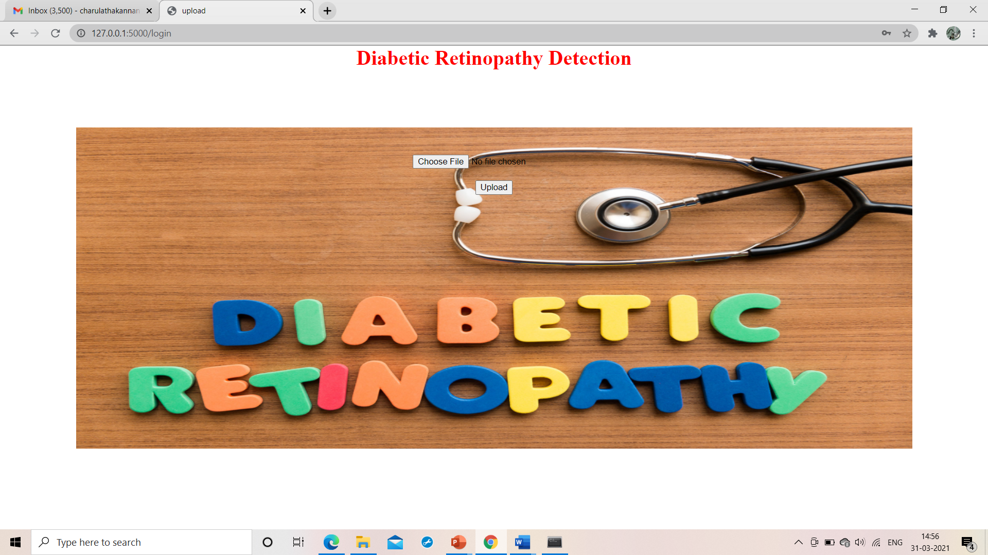
INPUT PAGE

Slide 34
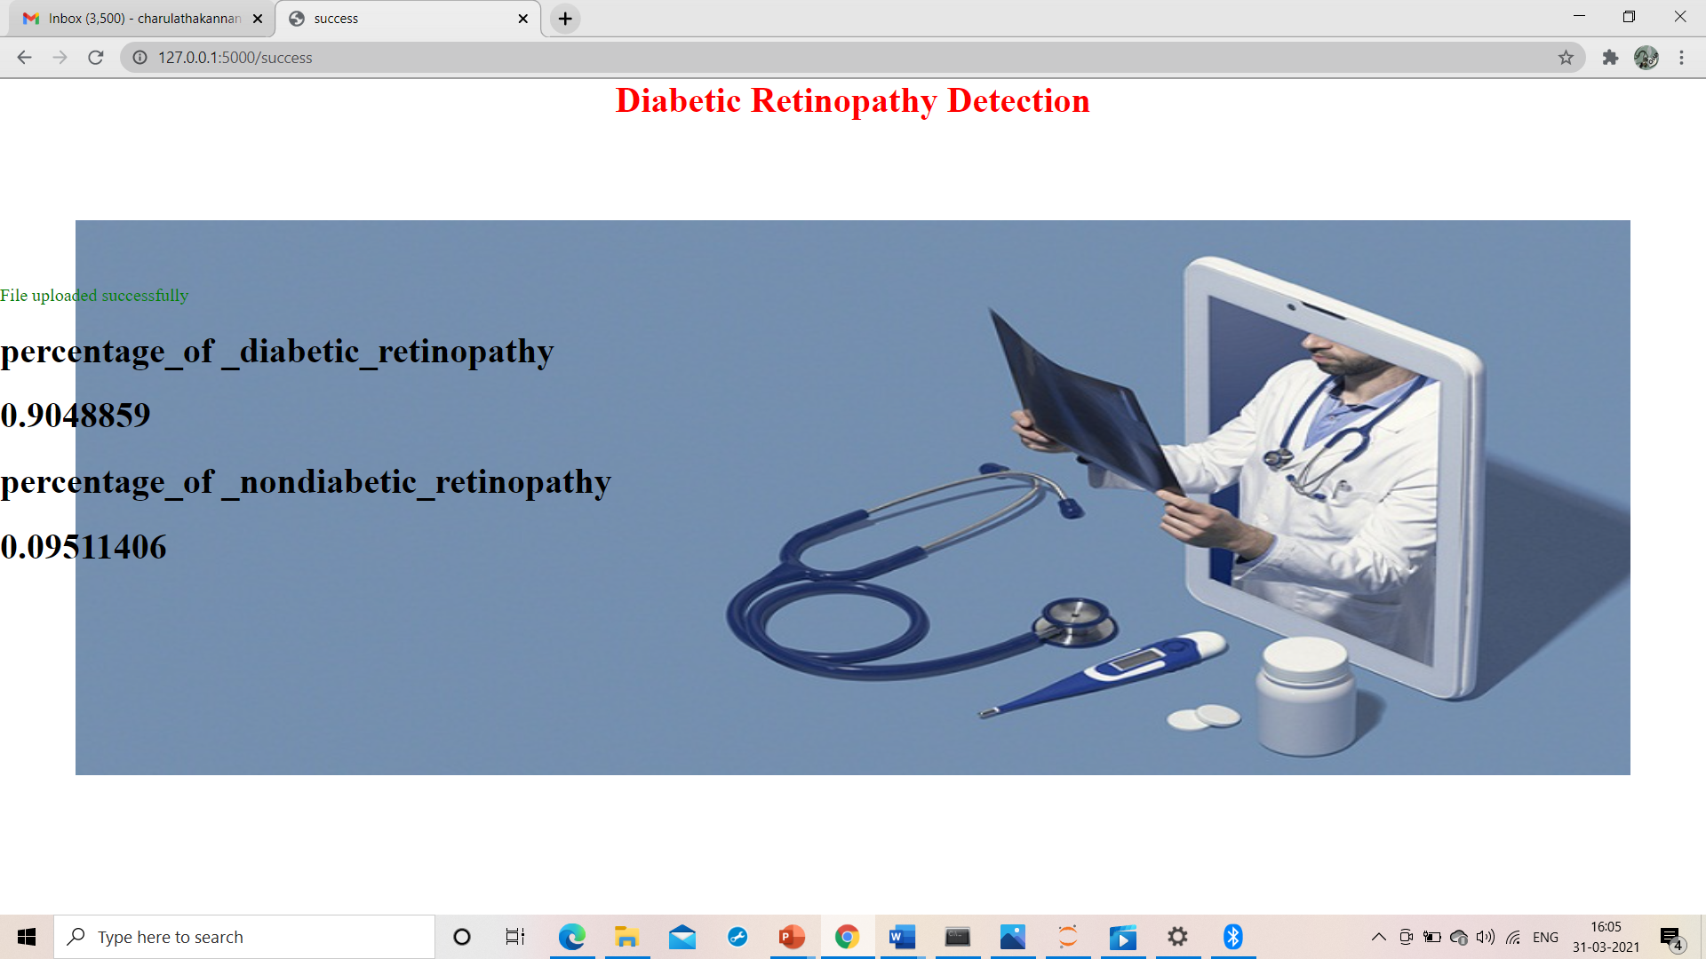
RESULT PAGE

Slide 35
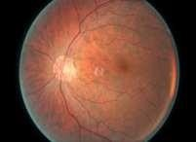
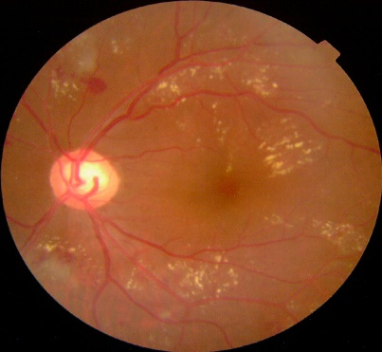
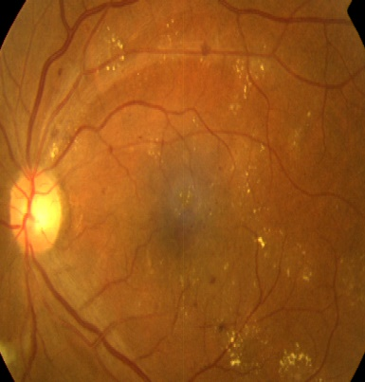
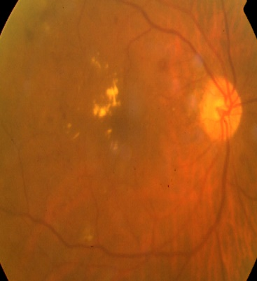
Input images

Slide 36
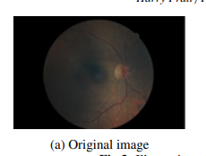
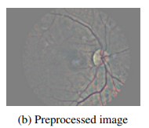
Preprocessed image

Slide 37
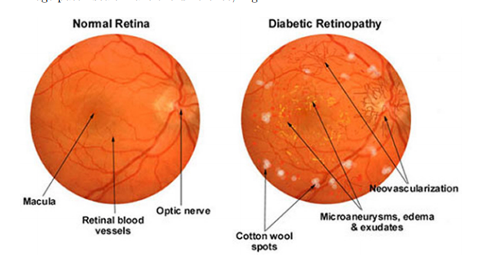
Normal and affected retina

Slide 38
Conclusion
On success of our project we can quickly detect Diabetic Retinopathy with high accuracy from our trained neural network and our system will help to reduce the damage cause by diabetic retinopathy at early stage. Our report generation system will give analysis of patient’s eye and will help doctors to take quick action .Our system can be further enhanced by training our neural network model on different eye disease so one can get one stop solution for all eye diseases.

Slide 39
Reference
A Brief Review of the Detection of Diabetic Retinopathy in Human Eyes Using Pre-Processing & Segmentation Techniques Yogesh Kumaran, Chandrashekar M. Patil  International Journal of Recent Technology and Engineering (IJRTE) ISSN: 2277-3878, Volume-7 Issue-4S2, December 2018
ADAM: A METHOD FOR STOCHASTIC OPTIMIZATION Diederik P. Kingma* University of Amsterdam, OpenAI dpkingma@openai.com Jimmy Lei Ba∗ University of Toronto jimmy@psi.utoronto.ca Published as a conference paper at ICLR 2015
Batch Normalization: Accelerating Deep Network Training b y Reducing Internal Covariate Shift Sergey Ioffe Google Inc., sioffe@google.com Christian Szegedy Google Inc., szegedy@google.com http://arxiv.org/abs/1502.03167v3
Convolutional Neural Networks for Diabetic Retinopathy Harry Pratta,∗ , Frans Coenenb , Deborah M Broadbentc , Simon P Hardinga,c, Yalin Zhenga,c International Conference On Medical Imaging Understanding and Analysis 2016, MIUA 2016, 6-8 July 2016, Loughborough, UK
Diabetic Retinopathy detection through integration of Deep Learning classification framework Alexander Rakhlin e-mail: rakhlin@gmx.net February 2017
Diabetic Retinopathy Detection Using Eye Images Mohit Singh Solanki 12419 mohitss@iitk.ac.in Supervisor: Dr. Amitabha Mukherjee April 18, 2015
Indian Diabetic Retinopathy Image Dataset (IDRiD): A Database for Diabetic Retinopathy Screening Research Prasanna Porwal 1,* ID , Samiksha Pachade Received: 5 June 2018; Accepted: 6 July 2018; Published: 10 July 2018
Prevalence and causes of vision loss in high-income countries and in Eastern and Central Europe in 2015: magnitude, temporal trends and projections Br J Ophthalmol: first published as 10.1136/bjophthalmol-2017-311258 on 15 March 2018.
Recent Development on Detection Methods for the Diagnosis of Diabetic Retinopathy Imran Qureshi 1 , Jun Ma 1,* and Qaisar Abbas 2 Received: 10 April 2019; Accepted: 27 May 2019; Published: 3 June 2019
Rethinking the Inception Architecture for Computer Vision Christian Szegedy Google Inc. szegedy@google.com Vincent Vanhoucke vanhoucke@google.com Sergey Ioffe sioffe@google.com Jonathon Shlens shlens@google.com December 2015

Slide 40
Thank you

